Slide 1
Carla Project Presentation
Sensing and Prediction Group
Name: Zhaoyang Li

Slide 2
CONTENTS
01
Carla Python API
02
The fundamentals of Object Recognition in deep learning
Implementation of real time yolo4 detection
03
Short analysis of performance
Accuracy of this implementation
04
Brief overview of image label progress
05
Brief overview of training (Ongoing)

Slide 3
01
Carla Python API
Generate Object (Cars and Pedestrians) and put sensors in these objects
Visualization coordinates about these objects and generate a plot to show the track

Slide 4
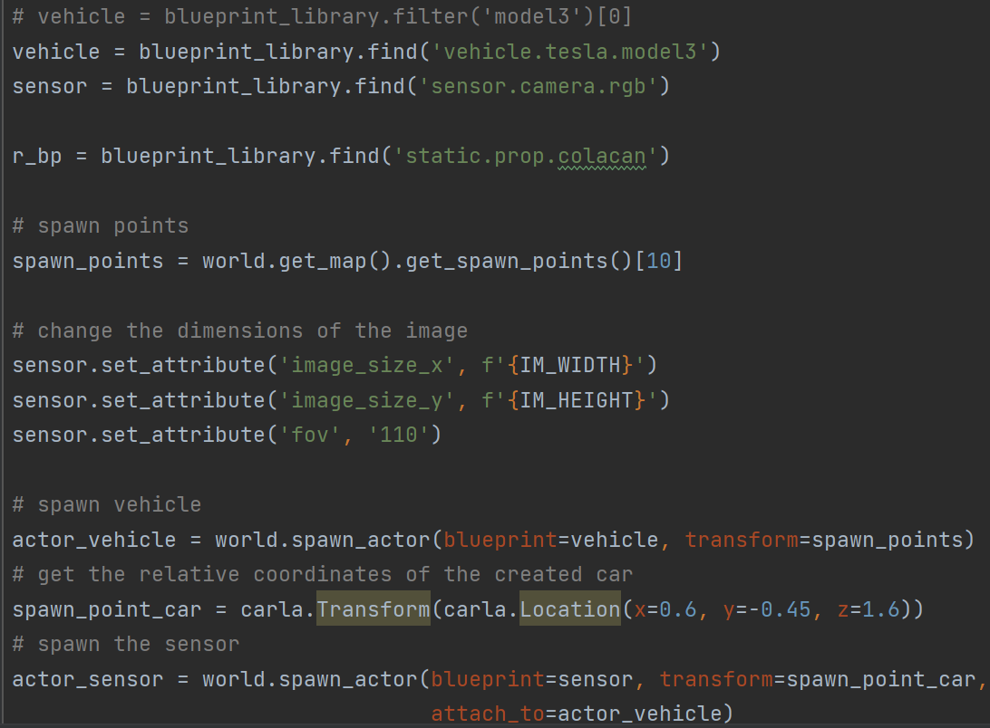
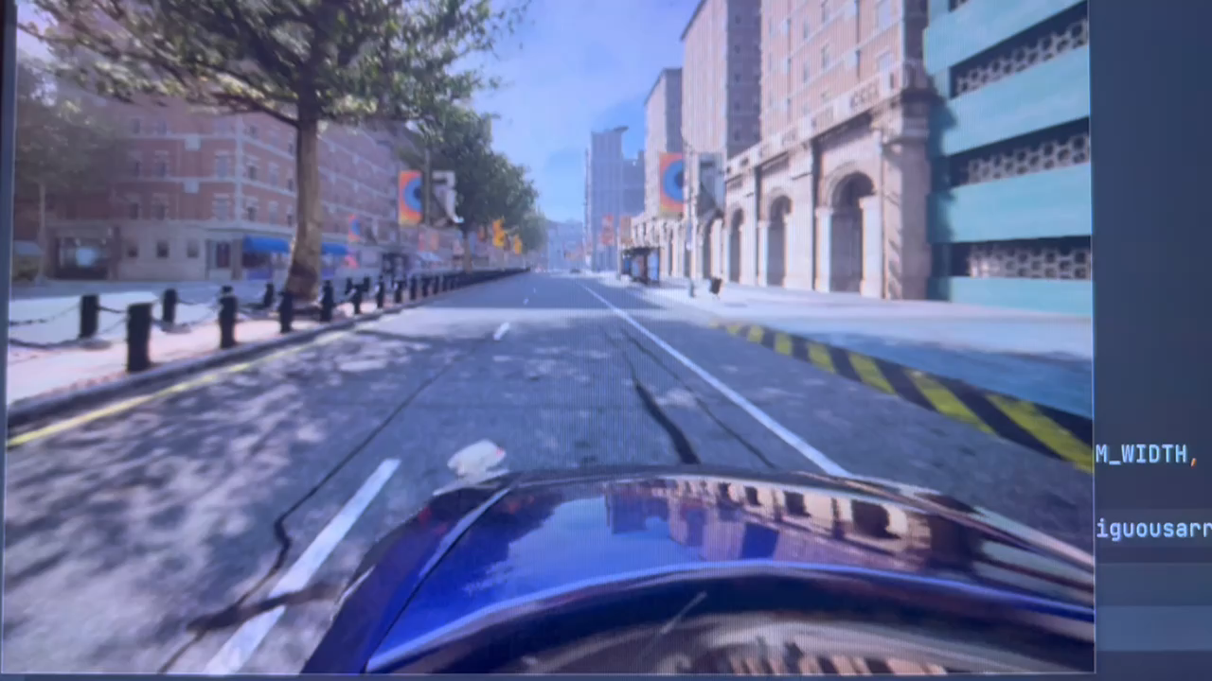
Generate Vehicle and RGB Camara
Code of generating a vehicle and camara
Video display

Slide 5
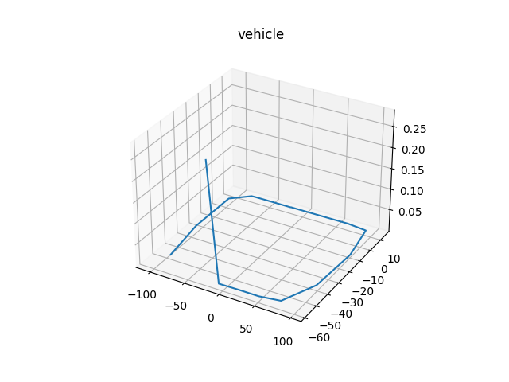
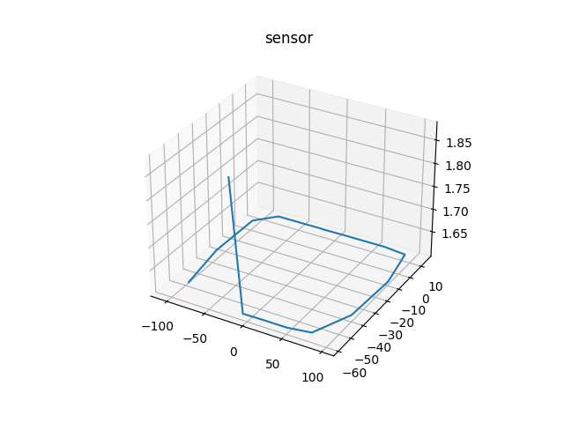
Visualization of Coordinates
Estimate whether the RGB camara is embedded in the vehicle
The vehicle
The RGB Camara

Slide 6
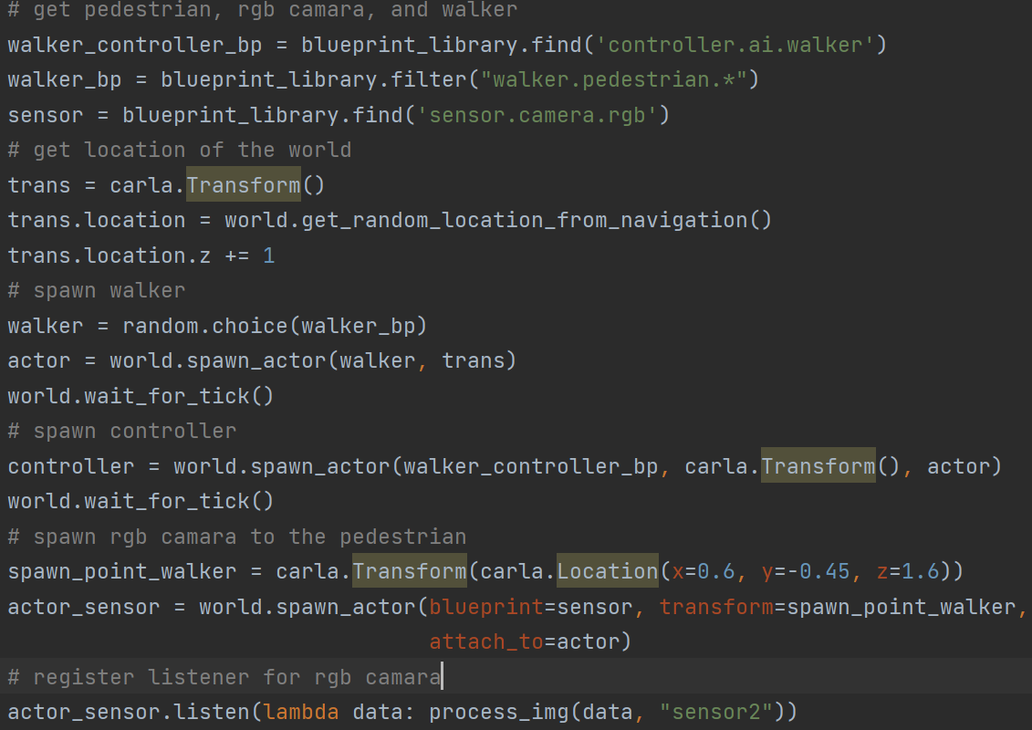
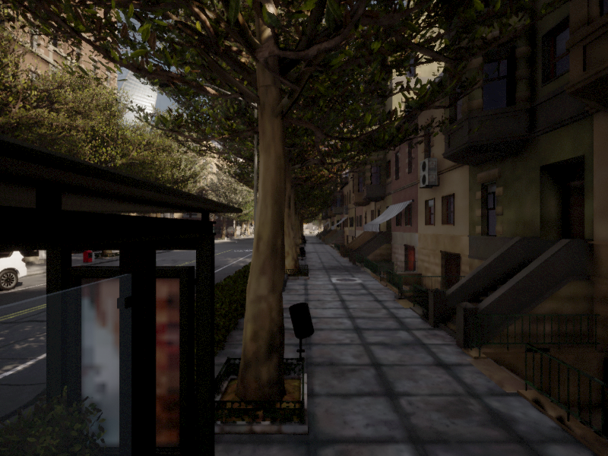
Randomly Pedestrian Objects and Take a Photo
Code of generating pedestrian and taking photo
Photo

Slide 7
02
The fundamentals of Object Recognition in deep learning & Implementation of real time yolo4 detection
What is object recognition in deep learning and some algorithms (Fast-RCNN and Yolo)
Implementation of YOLO

Slide 8
Object Recognition (Object Detection)
Definition of object recognition:
Combine with two computer vision tasks: Image Classification & Object Localization
Image Classification: Predict the type or class of an object in an image
Input: An image with a single object Output: A class label
Object Localization: Locate the objects in an image and indicate their location with a bounding box.
Input: An image with one or more objects Output: One or more bounding boxes
Object Detection: Locate the presence of objects with a bounding box and types or classes of the located objects in an image.
Input: An image with one or more objects Output: One or more bounding boxes,
& a class label for each bounding box.

Slide 9
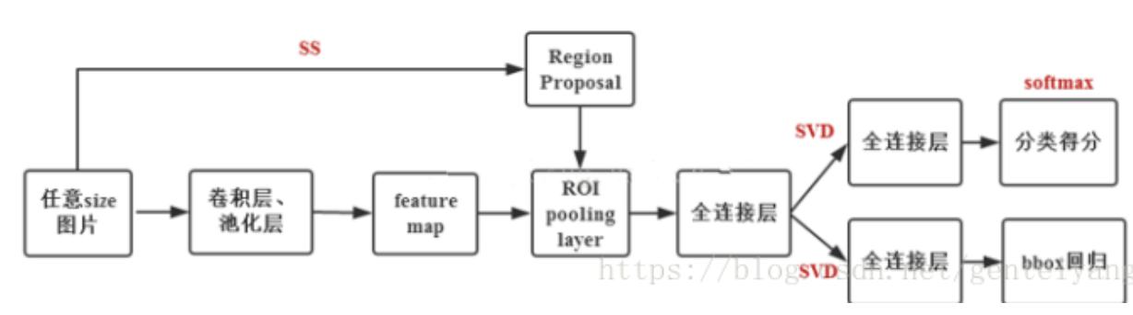
Fast-RCNN
The Architecture of Fast-RCNN
FCN
Score
Image
Convolution & Pooling
FCN
FCN
BBox
Regression
Selective Search: Check the existing small areas, merge the two most likely areas, repeat this step until the image is merged into one area, and finally output the candidate area
ROI: Refers to the mapping of the “selective box" on the feature map obtained after the SS is completed.
Faster-RCNN: The four steps are all handed over to the deep neural network to do, and all run on the GPU, which greatly improves the efficiency of the operation.

Slide 10
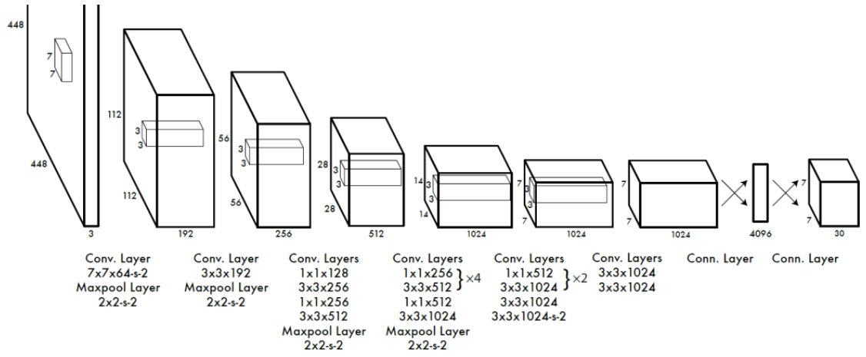
YOLO
The Architecture of YOLO
YOLO solves object detection as a regression problem. Based on a single end-to-end network, complete the input from the original image to the output of the object position and category.
Divide an image into a grid cell of SxS. If the center of an object falls in this grid, the network is responsible for predicting the object

Slide 11
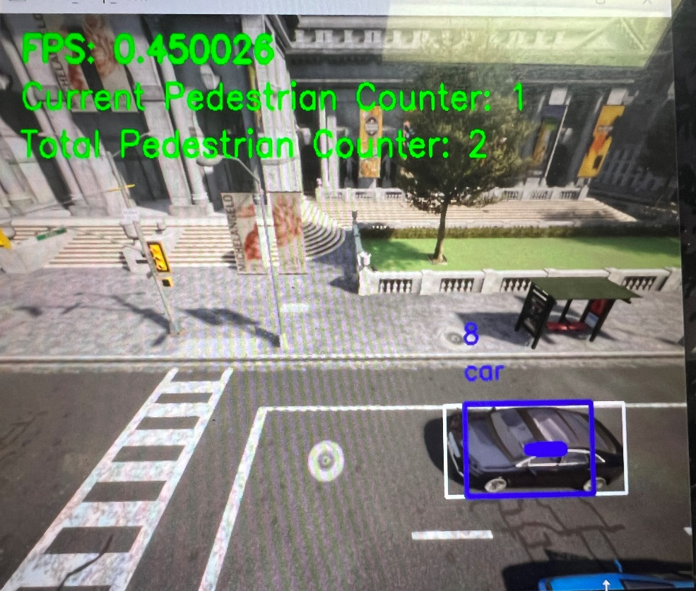
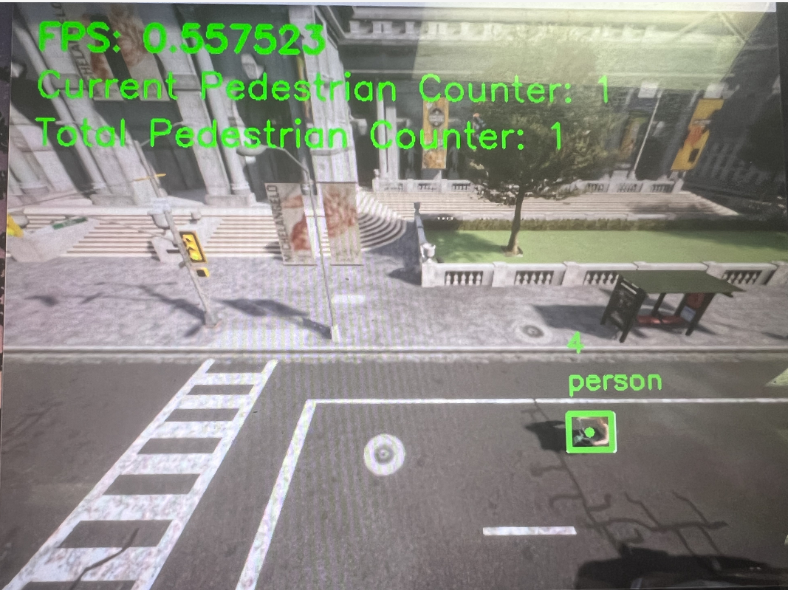
Implementation of Real Time YOLO4 Detection
1. Library and Tools: Python3.7 Tensorflow-gpu-2.6.0, Torch-1.10.0, pillow, numpy-1.21.2, OpenCV, sklean, CUDA-11.5, cuDNN-10.2
2. Trouble about Implementation: Mismatched about tensorflow, CUDA, and cuDNN (11.3->10.2)
3. Command: py main –c car (This is for trained model)

Slide 12
03
Analysis of Performance and Accuracy
Short analysis of performance
Short analysis of accuracy

Slide 13
Performance
Low Data Input Rate (Caused low FPS)
extract image in higher rate
optimize tracking algorithm
2. Longer processing time for each frame
Using better GPU
Using multiple GPU
Optimize neural network

Slide 14
Accuracy
Solution with priority:
-0. Using labeled image from carla to train the model (Recently work on)
-1. Using image of higher resolution -> require more computations
When cars run fast, there may be inconsistency with real-time box, which may influence the detection and tracking

Slide 15
04
Brief overview of image label progress
Show how to label data

Slide 16
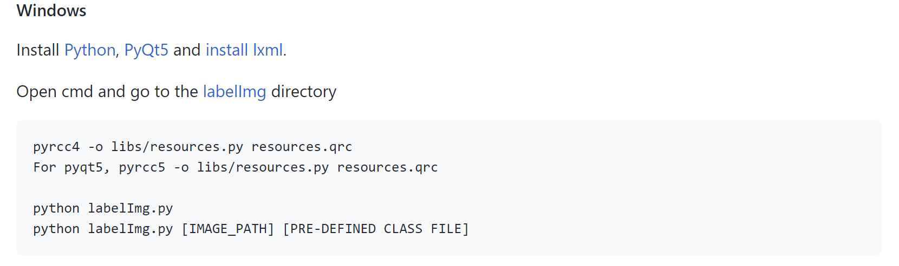
Labelling Data
Labelling Data API: https://github.com/tzutalin/labelImg

Slide 17
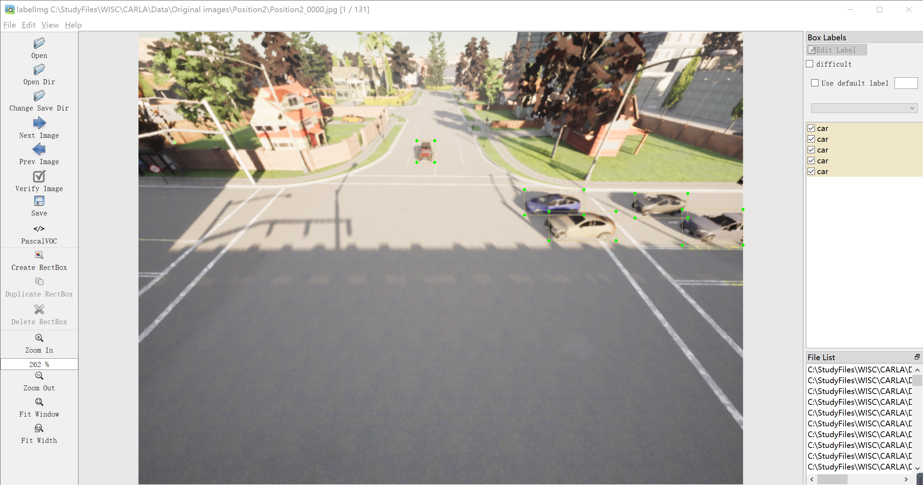
Labelling Data

Slide 18
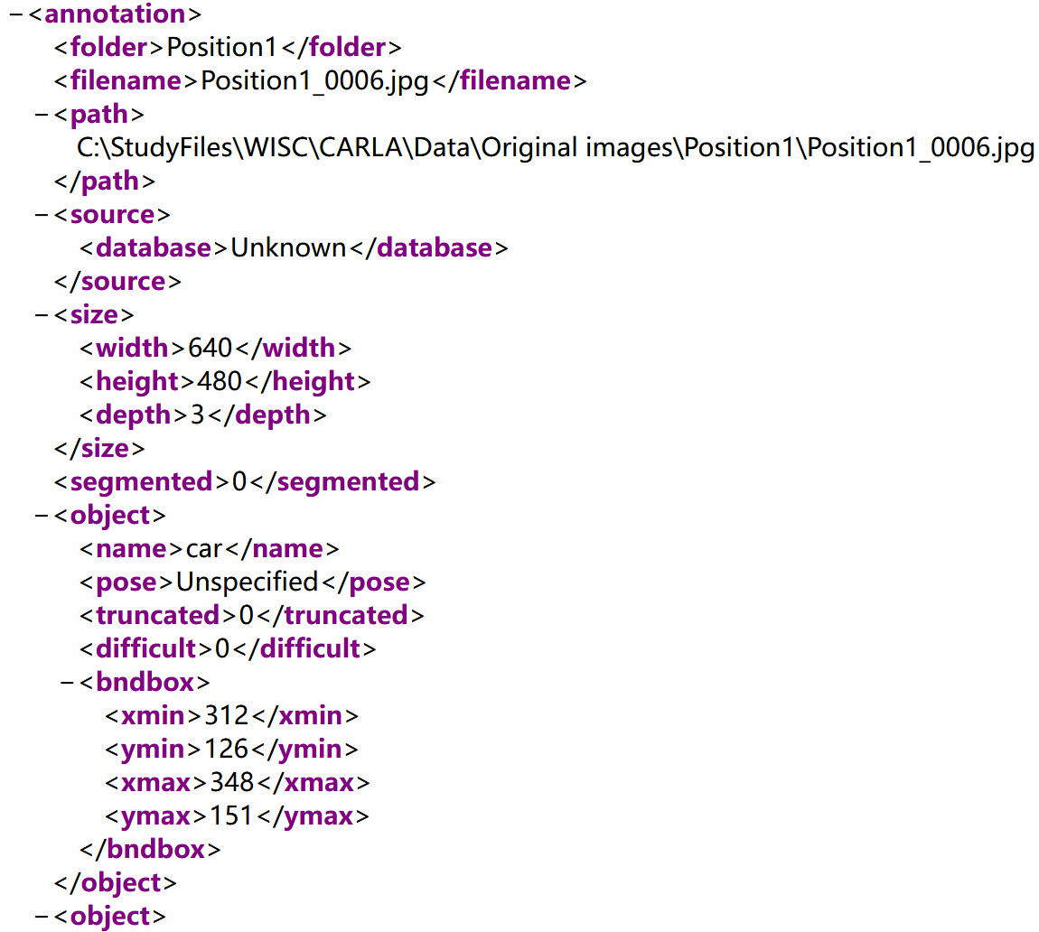
Labelling Data

Slide 19
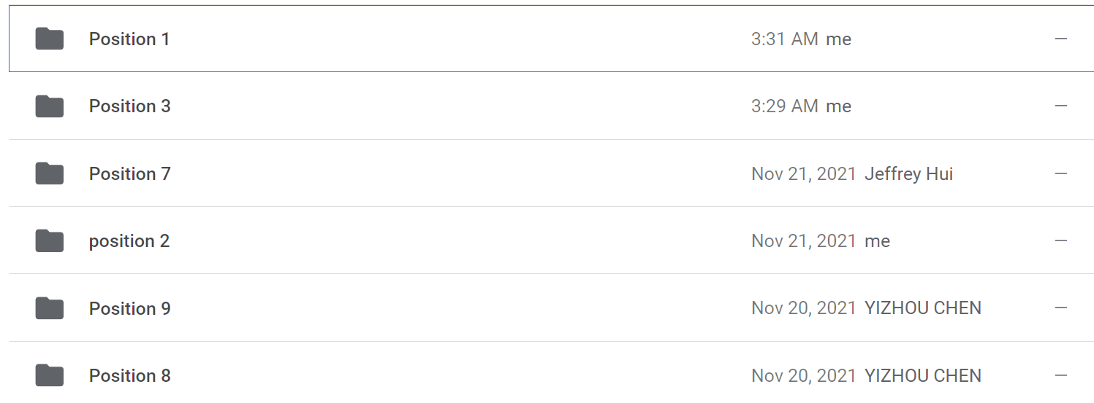
Labelling Data

Slide 20
05
Brief overview of training (Ongoing)
Data Preprocess

Slide 21
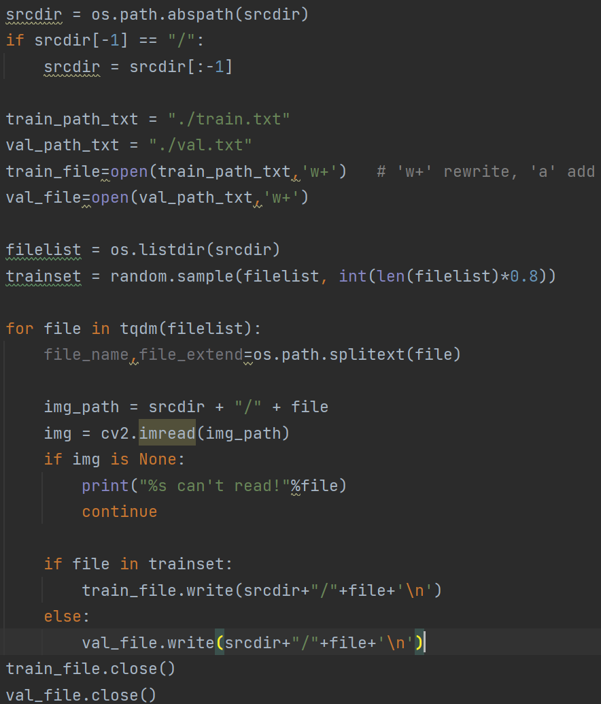
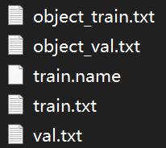
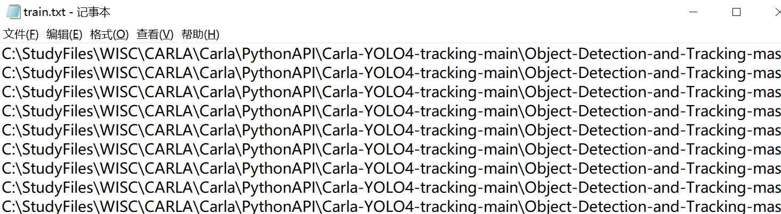
Classify the Train Set and Validation Set
Source: https://github.com/yehengchen/Object-Detection-and-Tracking/tree/master/OneStage/yolo/Train-a-YOLOv4-model

Slide 22
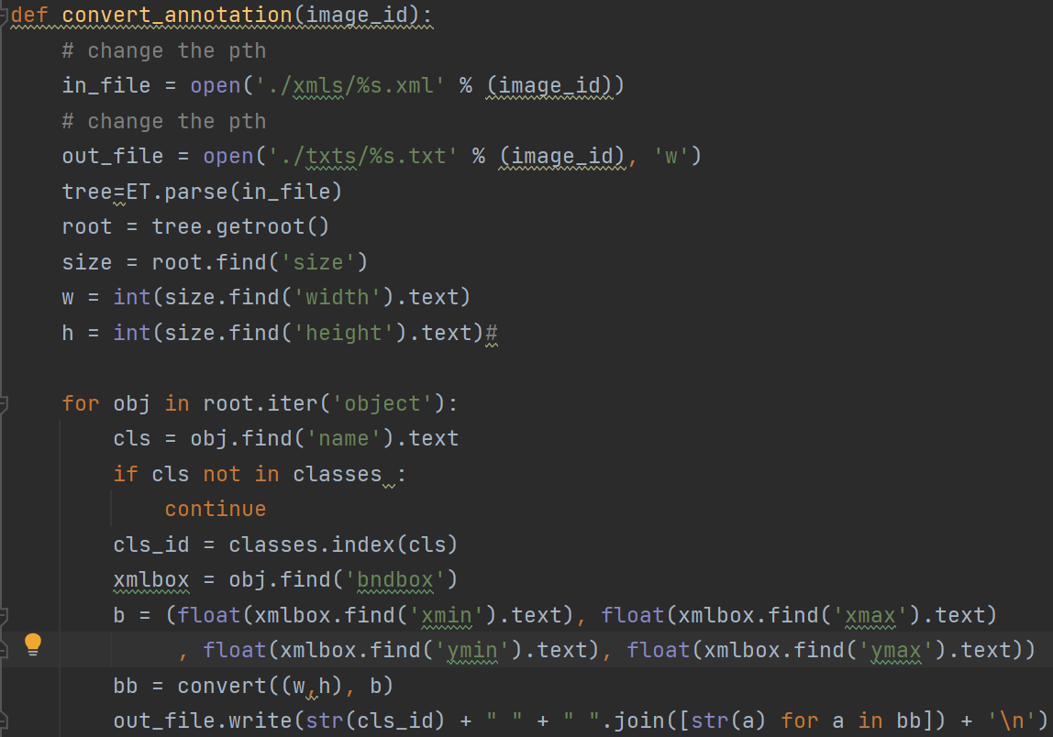
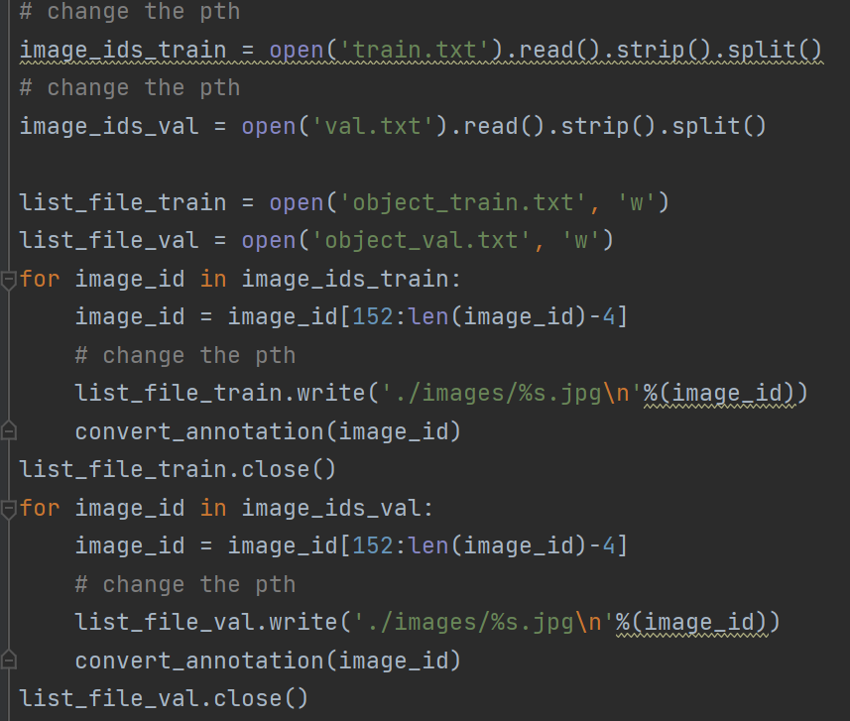
c
Change XML files to TXT file

Slide 23
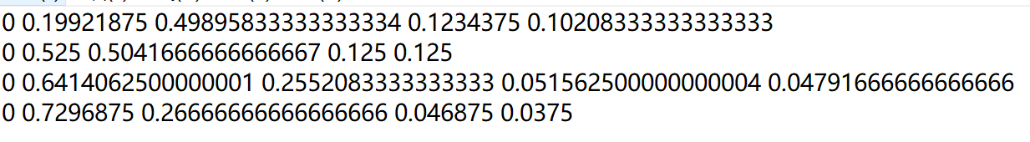
Labelling Data
The TXT file that is changed from XML file

Slide 24
Labelling Data
The TXT file that is changed from XML file

Slide 25
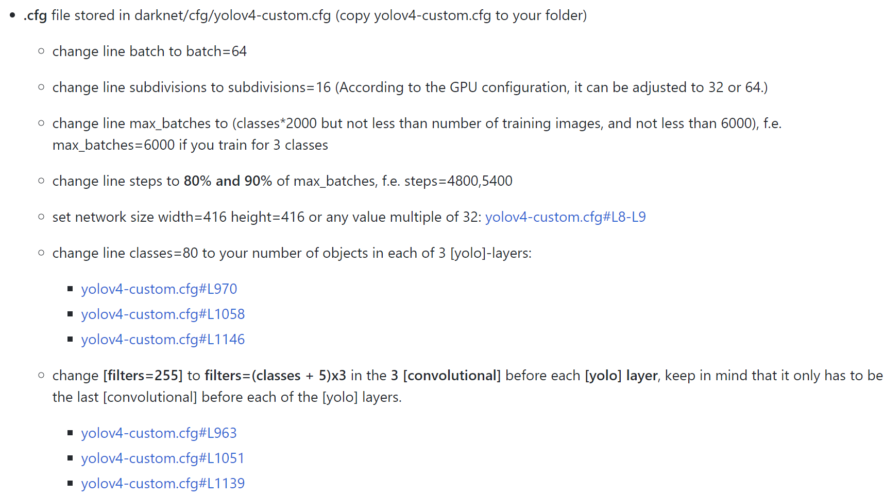
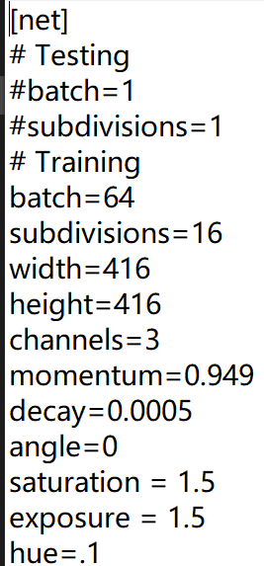
Set Configuration
Change the Configuration of Train

Slide 26
Training Problem and Future Work
1. The Source of teaching how to train of YOLO4 does not match the Windows version, so I will search for the version for Windows.
2. Train the model and evaluate the model
3. Visualize data (such as loss, accuracy)
4. Generate Heatmap to analyze the model
5. Try some methods to improve the performance and accuracy of the model

Slide 27
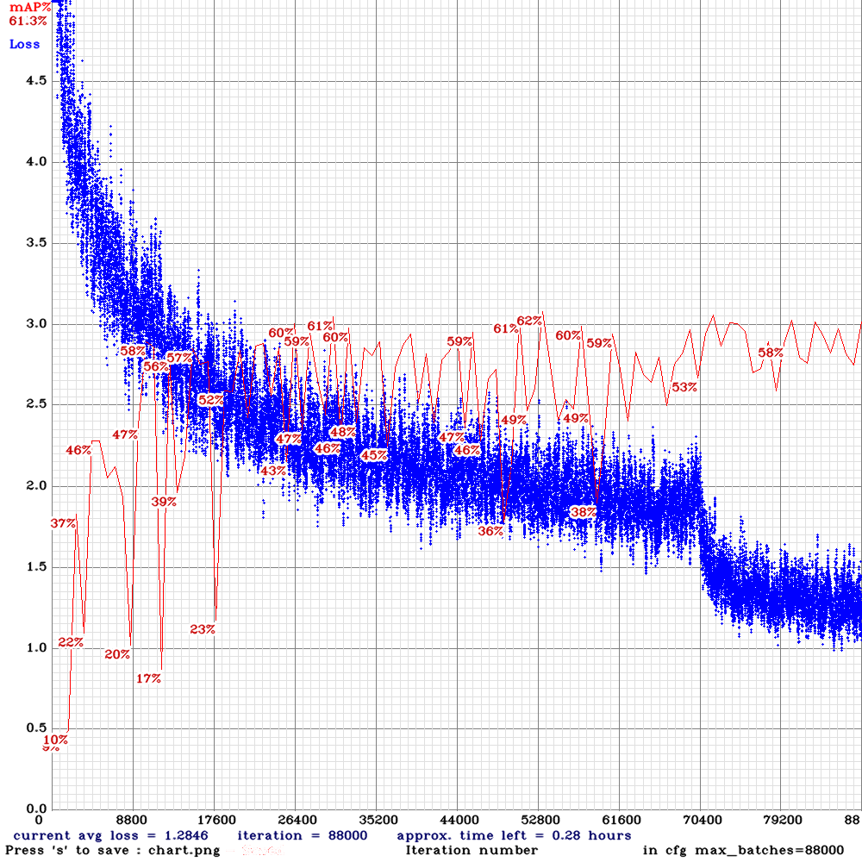
Training Problem and Future Work

Slide 28
THANK YOU

